Slide 1
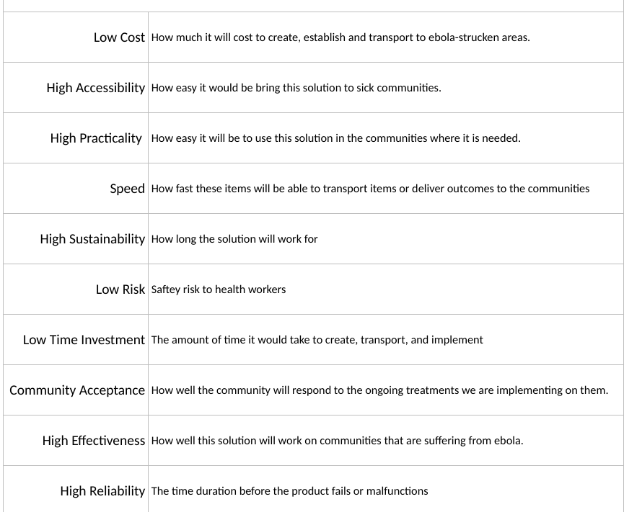
Ebola in Democratic Republic of Congo - Targeted Solution
Chlorinated Water Hand-Washing Station
Gabriel Calderon, Erica Nguyen, Zainab Lodhi, Clare LaBatti, Susan Pham
Global and Community Health 205-004 | George Mason University
Introduction
Democratic Republic of Congo:
Population- 85,281,024 million (Central Intelligence Agency)
Life expectancy: 58.1 years (Central Intelligence Agency)
Percentage of population below poverty line: 63% (Central Intelligence Agency)
Country has struggling healthcare system; they are low on medical supplies, workers, and equipment. Approximately 70% of population has little to no access to healthcare (USAID, 2017)
Ebola spreads primarily through contact with infected person’s bodily fluids or materials contaminated by fluids (Baylor)
Main Problems Identified:
Sanitation/Hand Washing
Lack of Healthcare Treatment Facilities
Equipment for Burial Ceremony
Treatment for EVD
Difficulty Diagnosing EVD
Specific Problem Addressed:
North Kivu, where the outbreak is occurring, is an unstable warzone (BBC News, 2019)
There is a lot of mistrust in the government and health professionals, leading to suspension of some of WHO services (WHO, 2019)
Local health clinics that treat ebola carriers do not have the sanitation capabilities to stop the spread of disease, yet the limited services they provide are too important to be replaced (BBC News, 2019)
Response from WHO has been to help sanitation efforts in these local clinics; cleaning or replacing contaminated equipment/materials (BBC News, 2019)
Proposed Solutions:
Hand-washing station that contains chlorine located in medical facilities
Armored truck that contains a small treatment unit for
Drone that contains medical supplies to clinics
Criteria listed in Fig. 1 are what we used in a weighted decision matrix to pick which of these problems would be most viable to address the problem.
Final Solution:
We have designed a handwashing sink, with foot pumps, to be installed in already existing health clinics; in order to provide methods of sanitation for medical workers with more public trust
Ebola cannot survive in water (2014), and the CDC uses these chlorine solutions to combat the virus (Center For Disease Control and Prevention)
This will help target lack of proper sanitation within existing local health clinics, in clinics that are already more trusted by public foreign organizations
The water will first come in from a local body of water which will go through a carbon filter
Right below this carbon filter will be a check valve, which will be used to prevent water going back into the body of water; check valves are used to prevent backflow (FDA)
Fig. 1
Sink Vessel: $32 (The Home Depot)
$32 x 3 = $96
Foot Pedal & Faucets: $115 (Katom Restaurant Supply, Inc.)
$115 x 3 = $345
Automatic hand dryer: $39.95 (AmeraProducts, Inc)
Check valve: $8.84 (The Home Depot)
We need 2 check valves, so $17.68
Carbon Filters: $13.09
$13.09 x 3 = $39.27
Total Cost: $57,568.30
REFERENCES:
Baylor College of Medicine. (n.d.). Ebola Virus. Retrieved from https://www.bcm.edu/departments/molecular-virology-and-microbiology/emerging-infections-and-biodefense/ebola-virus
BBC News. [BBC News]. (2019, March 7). Ebola in the DR Congo warzone - BBC News [Video File]. Retrieved from https://www.youtube.com/watch?v=fGESslPLluo
Center for Disease Control and Prevention. (n.d.). How to Make Mild (0.05%) Chlorine Solution. Retrieved from https://www.cdc.gov/vhf/ebola/pdf/chlorine-solution-liquid-mild.pdf
Central Intelligence Agency. (n.d.). The World Factbook: Congo, Democratic Republic of the. Retrieved from https://www.cia.gov/library/publications/the-world-factbook/geos/print_cg.html
Doctors Without Borders. (n.d.). Ebola outbreak in DRC. Retrieved from https://www.doctorswithoutborders.org/ebola-outbreak-drc
Ebola virus disease – Democratic Republic of the Congo. (2019, April 23). Retrieved from https://www.who.int/csr/don/11-april-2019-ebola-drc/en/
FDA. (n.d.). Plumbing Controls for Commercial Food Establishments. Retrieved from https://www.accessdata.fda.gov/ORAU/PlumbingControlsCom/PCC_summary.htm
Huber, C., & Reid, K. (2019, April 16). DRC conflict: Facts, FAQs, and how to help. Retrieved from https://www.worldvision.org/disaster-relief-news-stories/drc-conflict-facts
Poon, L. (2014, September 12). How Do You Catch Ebola: By Air, Sweat Or Water? Retrieved from https://www.npr.org/sections/goatsandsoda/2014/09/12/346114454/how-do-you-catch-ebola-by-air-sweat-or-water
USAID. (2017, April 21). Global Health | Democratic Republic of the Congo. Retrieved from https://www.usaid.gov/democratic-republic-congo/global-health
UNICEF. (2019, April 18). Water, Sanitation and Hygiene in Health Care Facilities: Global baseline report 2019. Retrieved from https://data.unicef.org/resources/wash-in-health-care-facilities/
WHO (2019, April 25). Ebola virus disease – Democratic Republic of the Congo. Retrieved from https://www.who.int/csr/don/25-april-2019-ebola-drc/en/
Utility Cost References:
National Tank Outlet. (n.d.). 50 Gallon Norwesco White Utility Tank. Retrieved from https://www.ntotank.com/50gallon-norwesco-white-utility-tank-x2895011?gclid=Cj0KCQjwh6XmBRDRARIsAKNInDGSXwUOQsn6KNAUjupwE5R-kVXIX0U9ZeQAfV9UCl8TvB5rYm6ZnlkaAvM6EALw_wcB
AmeraProducts, Inc. (n.d.). Alpine Hazel 402-10 Automatic Hand Dryer - White. Retrieved from https://www.ameraproducts.com/alpine-hazel-402-10-hand-dryer-white.htm?AdID=16760cm00cm03377&gclid=CjwKCAjwqqrmBRAAEiwAdpDXtNgfzhs8vOWPBj8tlLYnbGZzGsrw6U8mKE0FWq5Cob_IDZQRUdr3pRoCxP4QAvD_BwE
The Home Depot. Genova Products PVC-DWV Pipe, Schedule 40, Cellular Core, 2 in. x 10 ft.-70021F. Retrieved from https://www.homedepot.com/p/Genova-Products-PVC-DWV-Pipe-Schedule-40-Cellular-Core-2-in-x-10-ft-70021F/300282331
WholesaleSolar. (n.d.). Solar Panels. Retrieved from https://www.wholesalesolar.com/shop/solar-panels
The Home Depot. (n.d.). Glacier Bay Petite Aragon 8-3/8 in. Pedestal Sink Basin in White. Retrieved from https://www.google.com/shopping/product/10536615315174656289?lsf=seller:8740,store:3998342715601553145&prds=oid:13777026947227019350&q=sink%20bowl%20low%20cost&hl=en&ei=QvTJXIi_AuK0ggfErqfwBA&lsft=gclid:Cj0KCQjwh6XmBRDRARIsAKNInDFcDKuSbKhwPi70AdU7fJFi4MRQp9lTWS07RcEulsCQKpFLZar6C9MaApGaEALw_wcB,gclsrc:aw.ds
Katom Restaurant Supply, Inc. (n.d.). John Boos PB-FV-2LF Foot Valve w/ Goose Neck Spout. Retrieved from https://www.katom.com/416-PBFV2LF.html?gclid=Cj0KCQjwh6XmBRDRARIsAKNInDGKpRV7NkbiG7WsHwHghJVXyw3IF0yz3tsFZN-tXWlYTKNs3xY_fTYaAn_PEALw_wcB
Allied Electronics Automation. (n.d.). Dwyer Instruments CFS2-DNBPN-20. Retrieved from
https://www.alliedelec.com/product/dwyer-instruments/cfs2-dnbpn-20/70328674/?gclid=Cj0KCQjwn8_mBRCLARIsAKxi0GKjE7Pun0YJ59L503k9w6tfDZqW5ZW-Im4AXgQ4yGjzZKD_RO39kPYaAjqGEALw_wcB&gclsrc=aw.ds
Amazon. (n.d.). LNSLNM 500W Portable Power Station - 288Wh/90,000mAh Lithium Battery Backup, AC Gasless Solar Electric Generator, Uninterrupted UPS Solar Power Supply for Home/Camping/CPAP/Emergency. Retrieved from https://www.amazon.com/LNSLNM-Portable-Generator-Inverter-Camping/dp/B06WRXDK9K/ref=asc_df_B06WRXDK9K/?tag=hyprod-20&linkCode=df0&hvadid=198064505516&hvpos=1o3&hvnetw=g&hvrand=11495998718935817099&hvpone=&hvptwo=&hvqmt=&hvdev=c&hvdvcmdl=&hvlocint=&hvlocphy=9060038&hvtargid=pla-554500341032&psc=1
The Home Depot. (2019, February 23). Everbilt 1/2 in. Brass Sweat x Sweat Swing Check Valve-240-4-12-EB. Retrieved from https://www.homedepot.com/p/Everbilt-1-2-in-Brass-Sweat-x-Sweat-Swing-Check-Valve-240-4-12-EB/205816263
United States Plastic Corp. (n.d.). 30 Gallon Polyethylene Tank - 19" Dia. x 30" High. Retrieved from https://www.usplastic.com/catalog/item.aspx?sku=3003&gclid=Cj0KCQjwn8_mBRCLARIsAKxi0GIZTqU2zLuVB5ES6s0I8mLARHHT49L1xVegWQ_bawCHadrLYiszgLoaAjwoEALw_wcB
Google Express. (n.d.). HTH Ultimate Mineral Brilliance Chlorine Granule. Retrieved from https://express.google.com/u/0/product/9681130878275343429_6508501560989449710_121648710?utm_source=google_shopping&utm_medium=tu_prop&utm_content=eid-lsjeuxoeqt,eid-wuakzuqbuq
Google Express. (n.d.). Aqua Plumb 9115 - Carbon Water Filter Cartridge, 10. Retrieved from https://express.google.com/u/0/product/12551407453100422994_6162280658802725496_122521593?utm_source=google_shopping&utm_medium=tu_prop&utm_content=eid-lsjeuxoeqt,eid-wuakzuqbuq
RecPro. (n.d.). WFCO Artis 12v RV Potable Water Pump #PDS1RV25. Retrieved from https://www.recpro.com/wfco-artis-12v-rv-potable-water-pump-pds1rv25/?gclid=Cj0KCQjwh6XmBRDRARIsAKNInDFho218hnJdhrOxZgyRmRlTfWsPGfU0piJU3-5VCNeYc8k9Nfh1rpwaApf9EALw_wcB
Criteria used in decision matrix to select the problem
This water will then go into a water pump, which will then go into a 50 gallon water tank, located at the health clinic, to be stored and released when needed
The pump will be connected to and powered by solar panel, and a generator when weather prevents solar power
The water tank will have a sensor to detect water levels to prevent wasting water by pump, and a solar panel will power this sensor
There will be a chlorine tank which will be connected to the water tank. It will contain a throttle valve to control the amounts of chlorine going into the water tank and will be elevated above the tank
Water will be chlorinated, using mild (0.05%) water-to-chlorine solution, as recommended for handwashing (Center for Disease Control and Prevention
There will be three separate pipes which will connect to three sinks.
After the sink is used, there will be a pipe connecting from the sink, which will also contain another check valve to prevent backflow
After the check valve there will be another carbon filter to filter out this used water before it reenters the original water source
Utility Costs:
Below is a list of an estimate cost of all the materials needed to construct the system, with sources for sites selling materials needed. At the end we have a total with the entire cost.
RV Water Pump: $54.95 (RecPro)
50 Gallon Water Tank: $129.99 (National Tank Outlet)
Water Tank Level Sensor: $25.50 (Allied Electronics Automation)
Chlorine Tank
Small Tank: $65.21 (United States Plastic Corp)
Granulated chlorine: $89.89 (Google Express)
100W Solar Panel: $224.75 (WholesaleSolar)
$224.75 x 5 = $1123.75
-We need solar panels that support approx. 500 Watts to power our water pump (Polk)
Backup Generator: $271.99 (Amazon)
Pipes: 10 foot pvc pipe is about $8.44 (The Home Depot)
3 miles of this pipe = $26737.92
Notes:
https://www.slideshare.net/phicna2005/hand-hygiene-59234604 picture for history of handwashing website
https://dhhr.wv.gov/healthprep/eventsandannouncements/Pages/Information-on-Cleaning-and-Decontaminating-Ebola.aspx
website for picture for making chlorine solution cdc stuff

